Slide 1
THE SCIENTIFIC REVOLUTION
THEORIES, FEATURES AND TECHNOLOGIES

Slide 2
INTRODUCTION :
The Scientific Revolution was a series of events that marked the emergence of modern science during the early modern period, when developments in mathematics, physics, astronomy, biology (including human anatomy) and chemistry transformed the views of society about nature.
The Scientific Revolution took place in Europe towards the end of the Renaissance period and continued through the late 18th century, influencing the intellectual social movement known as the Enlightenment.
It replaced the Greek view of nature that had dominated science for almost 2,000 years. The Scientific Revolution was characterized by an emphasis on abstract reasoning, quantitative thought, an understanding of how nature works, the view of nature as a machine, and the development of an experimental scientific method.
Early phase of Scientific revolution, from 1450 to 1632( the year when Galileo published Dialogue Concerning the Two Chief World System) known as Scientific Renaissance. This period focused on the restoration and recovery of the natural knowledge of the ancients. Later, the process shifted to Scientific Revolution of the 17th century, when scientists shifted from recovery to innovation.
The Scientific Revolution is traditionally assumed to start with the Copernican Revolution (initiated in 1543) and to be complete in the "grand synthesis" of Isaac Newton's 1687 Principia.

Slide 3
EMPIRICISM AND SCIENTIFIC EXPERIMENTATION:
By the start of the Scientific Revolution, empiricism had already become an important component of science and natural philosophy.
Empiricism in the philosophy of science emphasizes evidence, especially as discovered in experiments. It is a fundamental part of the scientific method that all hypotheses and theories must be tested against observations of the natural world rather than resting solely on a priori reasoning, intuition, or revelation.
Francis bacon is called the father of empiricism. His works established and popularised inductive methodologies for scientific inquiry. His demand for a planned procedure of investigating all things natural marked a new turn in the rhetorical and theoretical framework for science, much of which still surrounds conceptions of proper methodology today.
His work Novum Organum was published in 1620. He argued that man is "the minister and interpreter of nature“, and that "effects are produced by the means of instruments and helps", and later that "nature can only be commanded by obeying her“.
William Gilbert was an early advocate of scientific experimentation. He passionately rejected the prevailing Aristotelian philosophy. His book De Magnete was written in 1600, and he is regarded by some as the father of electricity and magnetism. In this work, he describes many of his experiments with his model Earth called the terrella. From these experiments, he concluded that the Earth was itself magnetic and that was the reason that compasses points to the North.

Slide 4
SCIENTIFIC SOCIETIES :
The growing flood of information that resulted from the Scientific Revolution put heavy strains upon old institutions and practices.
Natural philosophers had to be sure of their data, and to that end they required independent and critical confirmation of their discoveries. New means were created to accomplish these ends.
Scientific societies sprang up, beginning in Italy in the early years of the 17th century and culminating in the two great national scientific societies that mark the zenith of the Scientific Revolution: the Royal Society of London for Improving Natural Knowledge in 1662, and the Académie des Sciences of Paris, formed in 1666.
In these societies and others like them all over the world, natural philosophers could gather to examine, discuss, and criticize new discoveries and old theories.
To provide a firm basis for these discussions, societies began to publish scientific papers. New canons of reporting were devised so that experiments and discoveries could be reproduced by others. Precision in language and willingness to share experimental methods were given priority in this task.

Slide 5
ASTRONOMY:
The Scientific Revolution began in astronomy.
The astronomy of the late Middle Ages was based on the geocentric model described by Ptolemy in antiquity.
Polish astronomer Nicolas Copernicus was the first to propound a comprehensive heliocentric theory (1543).
The discoveries of Johannes Kepler and Galileo gave the theory credibility.
Kepler was an astronomer who, using the accurate observations of Tycho Brahe, proposed that the planets move around the sun not in circular orbits, but in elliptical ones. Together with his other laws of planetary motion, he created a model of the solar system which was an improvement over Copernicus' original system.
Galileo's main contributions to the acceptance of the heliocentric system were his mechanics, the observations he made with his telescope as well as his detailed presentation of the case.
Using an early theory of inertia, Galileo could explain why rocks dropped from a tower fall straight down even if the earth rotates. His observations of the moons of Jupiter, the phases of Venus, the spots on the sun, and mountains on the moon all helped to discredit the Aristotelian philosophy and the Ptolemaic theory of the solar system.
By the end of the 17th century, heliocentric theory was generally accepted by astronomers.

Slide 6
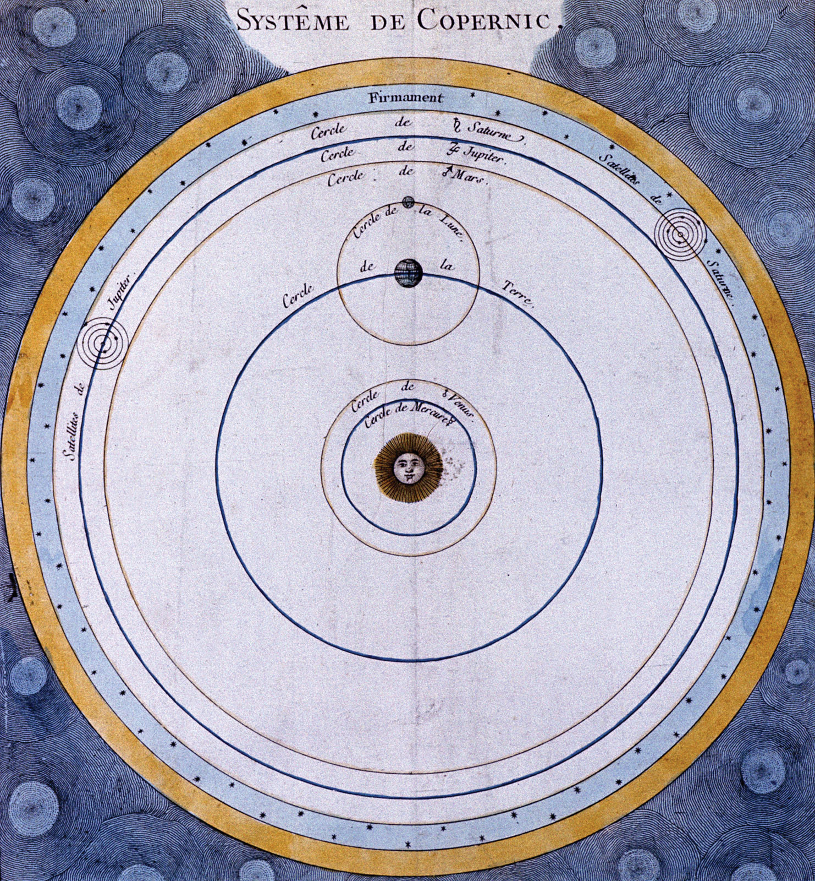
In a book called On the Revolutions of the Heavenly Bodies (that was published as Copernicus lay on his deathbed), Copernicus proposed that the Sun, not the Earth, was the centre of the Solar System. Such a model is called a heliocentric system.

Slide 7
ISAAC NEWTON (1642-1727)
Isaac Newton is best know for his theory about the law of gravity.
Newton’s published his major work “Principia” in 1687, a landmark work that established the universal laws of motion and gravity. Newton’s second major book, “Opticks,” detailed his experiments to determine the properties of light.
By deriving Kepler's laws of planetary motion from his mathematical description of gravity, and then using the same principles to account for the trajectories of comets, the tides, the precession of the equinoxes, and other phenomena, Newton removed the last doubts about the validity of the heliocentric model of the cosmos. This work also demonstrated that the motion of objects on Earth and of celestial bodies could be described by the same principles.
His laws of motion were to be the solid foundation of mechanics; his law of universal gravitation combined terrestrial and celestial mechanics into one great system that seemed to be able to describe the whole world in mathematical formulae.
By means of the concept of force, Newton was able to synthesize two important components of the Scientific Revolution, the mechanical philosophy and the mathematization of nature.

Slide 8
MECHANICS:
The battle for Copernicanism was fought in the realm of mechanics as well. Galileo’s contributions to the science of mechanics were related directly to his defense of Copernicanism.
He developed the foundations for a new physics that was both highly mathematizable and directly related to the problems facing the new cosmology.
Interested in finding the natural acceleration of falling bodies, he was able to derive the law of free fall (the distance, s, varies as the square of the time, t²).
Combining this result with his rudimentary form of the principle of inertia enabled him to meet the traditional physical objections to Earth’s motion: since a body in motion tends to remain in motion, projectiles and other objects on the terrestrial surface will tend to share the motions of Earth, which will thus be imperceptible to someone standing on Earth.
French philosopher René Descartes was principally concerned with the conceptions of matter and motion as part of his general program for science—namely, to explain all the phenomena of nature in terms of matter and motion. This program, known as the mechanical philosophy, came to be the dominant theme of 17th-century science.
According to Descartes, all natural phenomena depend on the collisions of small particles, and so it is of great importance to discover the quantitative laws of impact. This was done by Descartes’s disciple physicist Christiaan Huygens, who formulated the laws of conservation of momentum and of kinetic energy.

Slide 9
OPTICS:
Johannes Kepler published Astronomiae Pars Optica (The Optical Part of Astronomy) in 1604.
Kepler, taking his lead from the writings of the 13th-century opticians like Roger Bacon, Robert Grosseteste, and John Pecham, set the tone for the science in the 17th century.
Kepler introduced the point by point analysis of optical problems, tracing rays from each point on the object to a point on the image. Just as the mechanical philosophy was breaking the world into atomic parts, so Kepler approached optics by breaking organic reality into what he considered to be ultimately real units.
He developed a geometric theory of lenses, providing the first mathematical account of Galileo’s telescope.
Using mechanical analogies, Descartes was able to derive mathematically many of the known properties of light, including the law of reflection and the newly discovered law of refraction.
Newton proposed new theory of colours. Traditional theory considered colours to be the result of the modification of white light. Newton upset the traditional theory of colours by demonstrating in an impressive set of experiments that white light is a mixture out of which separate beams of coloured light can be separated. He associated different degrees of refrangibility with rays of different colours, and in this manner he was able to explain the way prisms produce spectra of colours from white light.

Slide 10
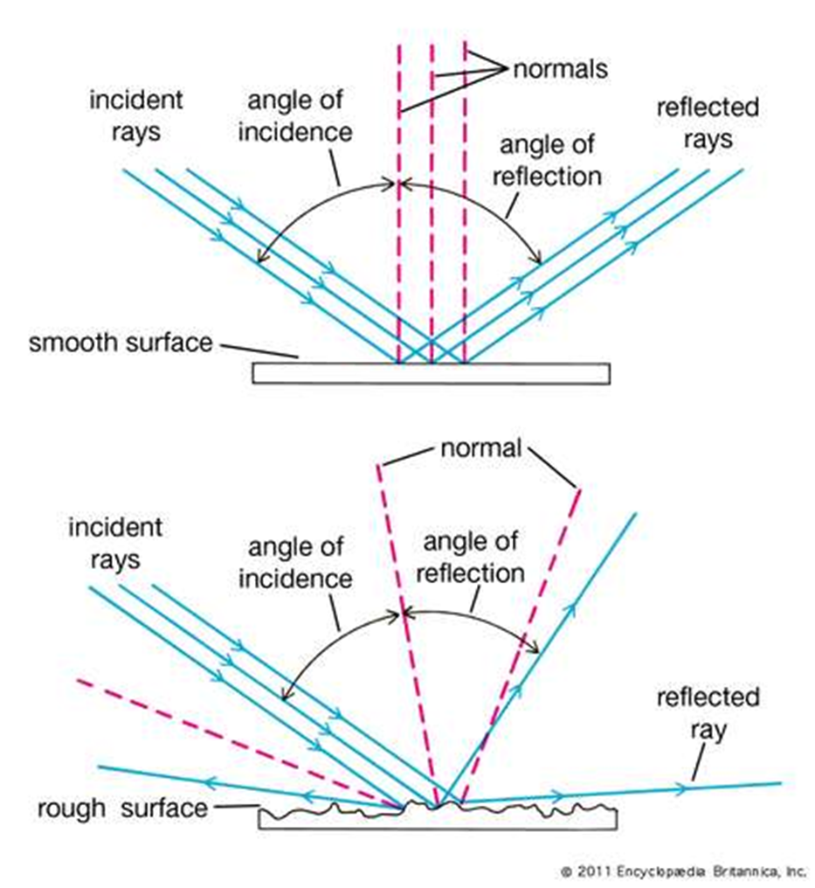
Descartes sought to incorporate the phenomena of light into mechanical philosophy by demonstrating that they can be explained entirely in terms of matter and motion. Using mechanical analogies, he was able to derive mathematically many of the known properties of light, including the law of reflection and the newly discovered law of refraction.

Slide 11
CHEMISTRY:
Chemistry, and its antecedent alchemy, became an increasingly important aspect of scientific thought in the course of the 16th and 17th centuries.
Practical attempts to improve the refining of ores and their extraction to smelt metals were an important source of information for early chemists in the 16th century, among them Georg Agricola (1494–1555), who published his great work De re metallica in 1556. His work describes the highly developed and complex processes of mining metal ores, metal extraction and metallurgy of the time. His approach removed the mysticism associated with the subject, creating the practical base upon which others could build.
English chemist Robert Boyle (1627–1691) is considered to have refined the modern scientific method for alchemy and to have separated chemistry further from alchemy. Boyle is largely regarded today as the first modern chemist, and therefore one of the founders of modern chemistry.
He is best known for Boyle's law, which he presented in 1662: ^{t}he law describes the inversely proportional relationship between the absolute pressure and volume of a gas, if the temperature is kept constant within a closed system.
He believed all theories must be tested experimentally before being regarded as true. The work contains some of the earliest modern ideas of atoms, molecules, and chemical reaction, and marks the beginning of the history of modern chemistry.

Slide 12
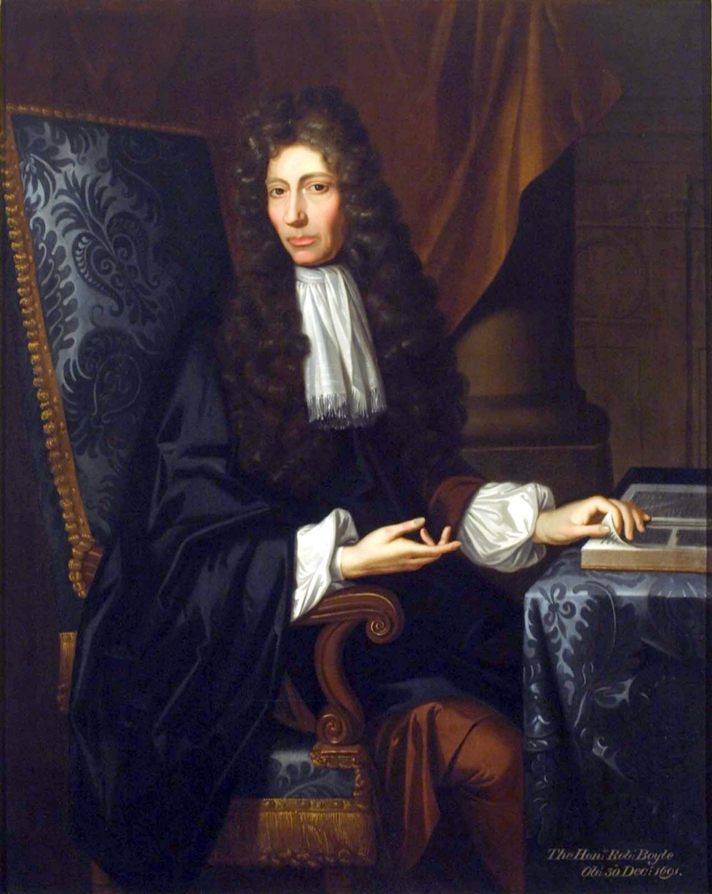
Although Robert Boyle ’s chief scientific interest was chemistry, his first published scientific work, New Experiments Physico-Mechanicall, Touching the Spring of the Air, and Its Effects (1660), concerned the physical nature of air, as displayed in a brilliant series of experiments in which he used an air pump to create a vacuum. The second edition of this work, published in 1662, delineated the quantitative relationship that Boyle derived from experimental values, later known as Boyle’s law: that the volume of a gas varies inversely with pressure.

Slide 13
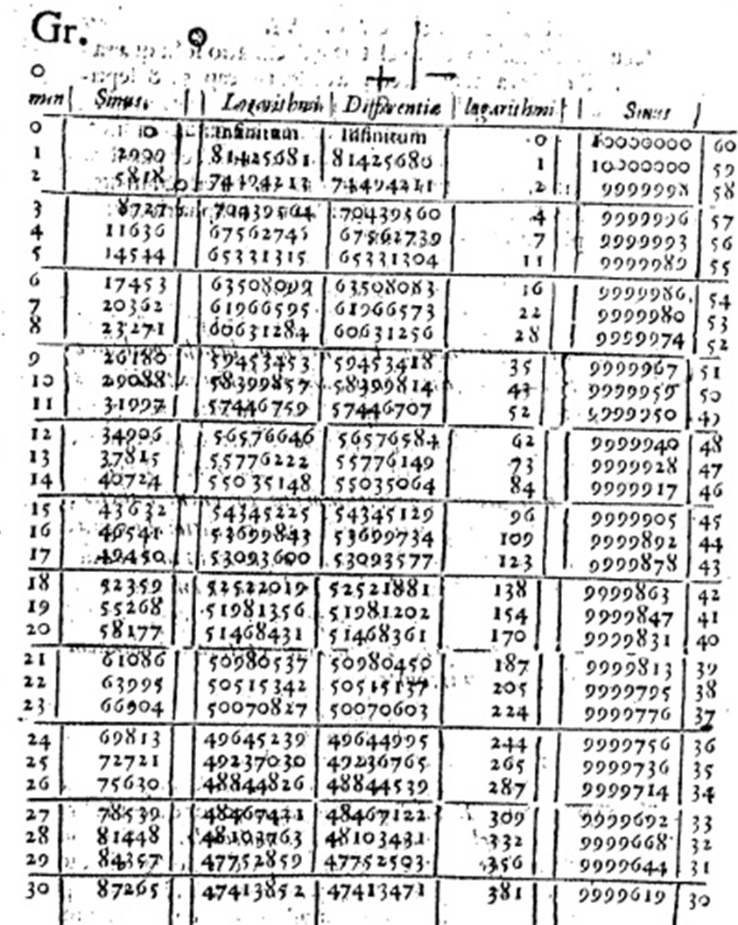
One of the most important mathematical advance of the early period of the Scientific Revolution was the invention of logarithms in 1594 by John Napier of Scotland. Napier spent the next 20 years of his life developing his theory and computing an extensive table of logarithms to aid in calculation. In 1614, he published Description of the Marvelous Canon of Logarithms, which contained the fruits of these labors.

Slide 14

The common symbol for infinity, ∞, was invented by the English mathematician John Wallis in 1655.

Slide 15
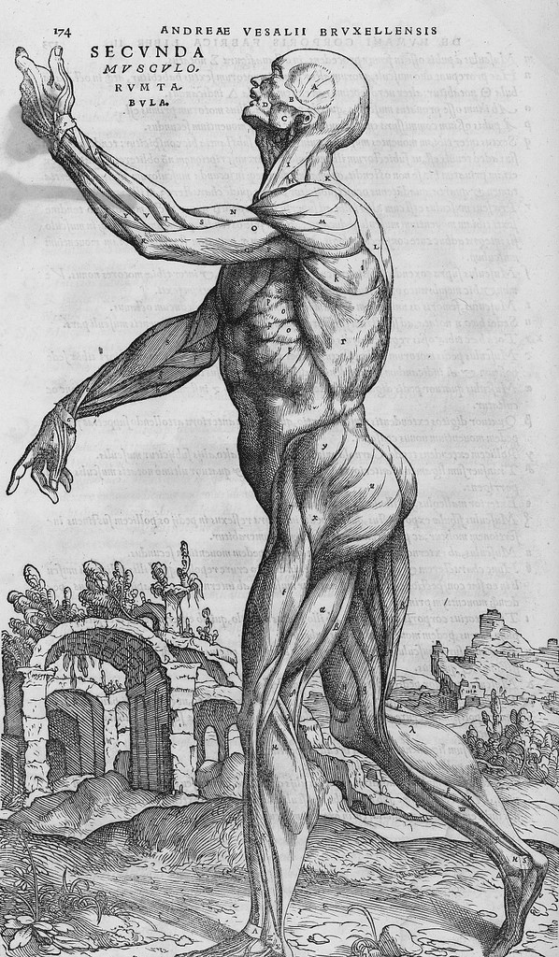
Standing figure–muscle plate from De humani corporis fabrica, libri septum, Basile: 1543 by Andreas Vesalius (1514-1564)

Slide 16
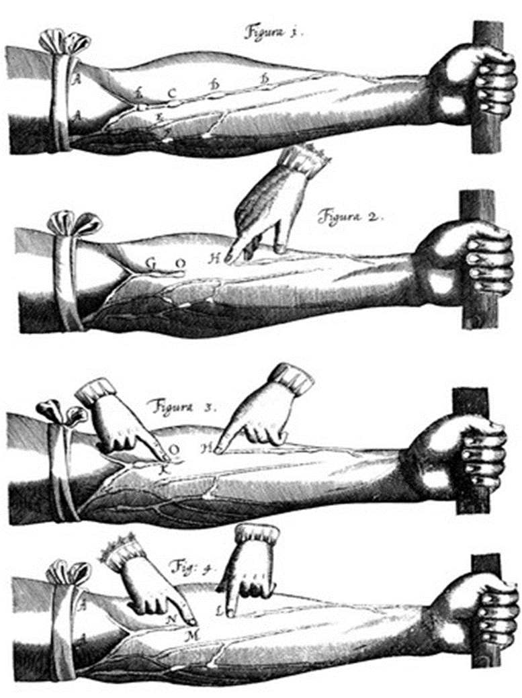
In 1628, the English physician William Harvey announced a revolutionary theory stating that blood circulates repeatedly throughout the body. He relied on experimentation, comparative anatomy and calculation to arrive at his conclusions.

Slide 17
Helpful Links:
https://www.britannica.com/science/Scientific-Revolution
http://resourcesforhistoryteachers.pbworks.com/w/page/138514926/Women%20of%20the%20Scientific%20Revolution

